Slide 1


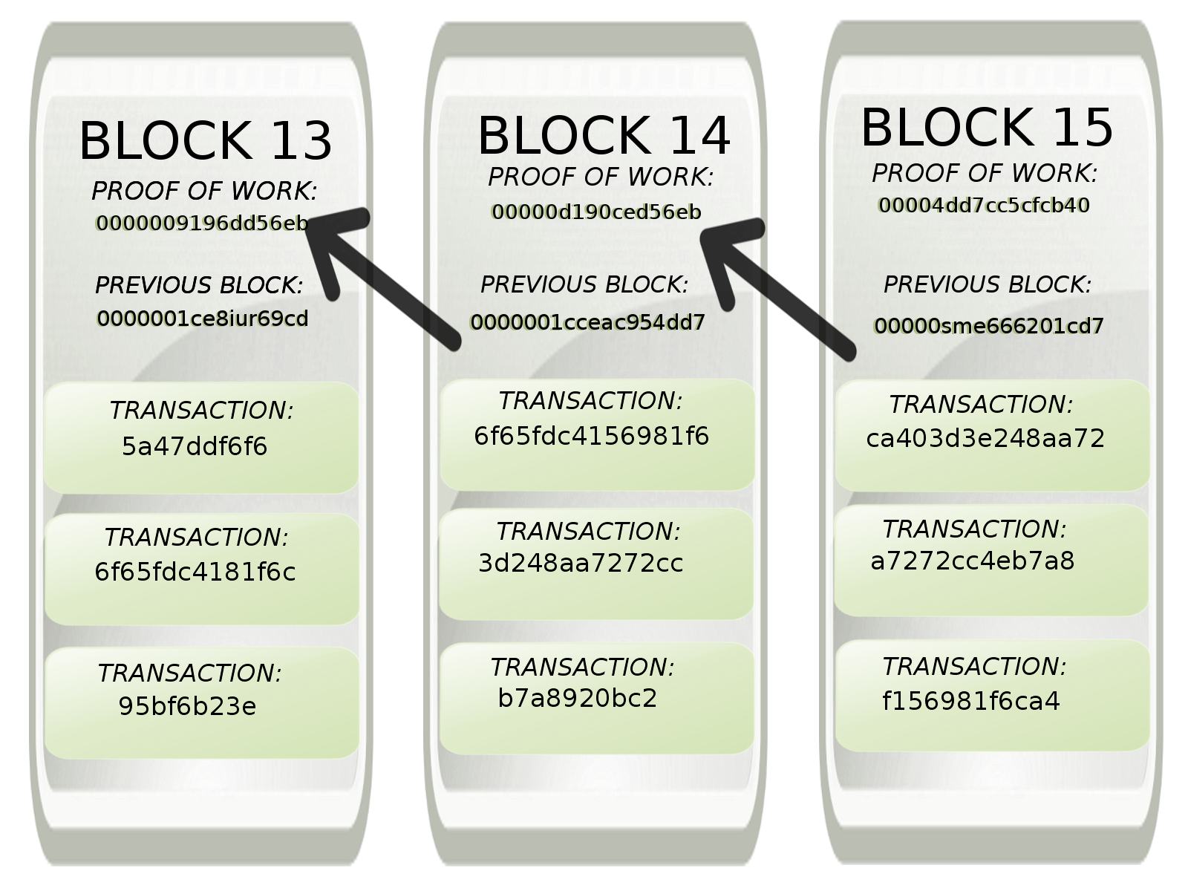
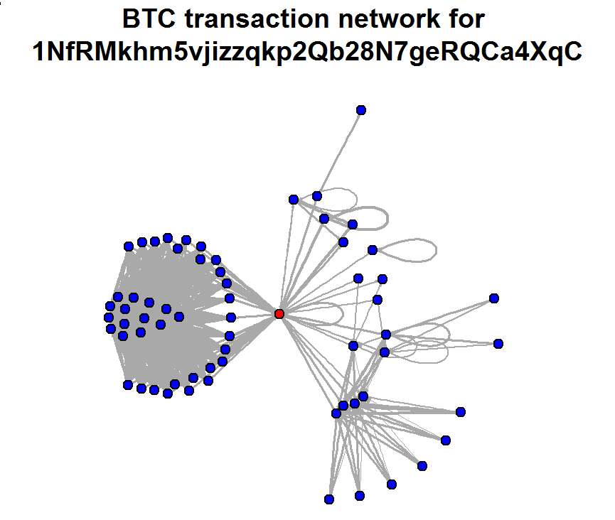
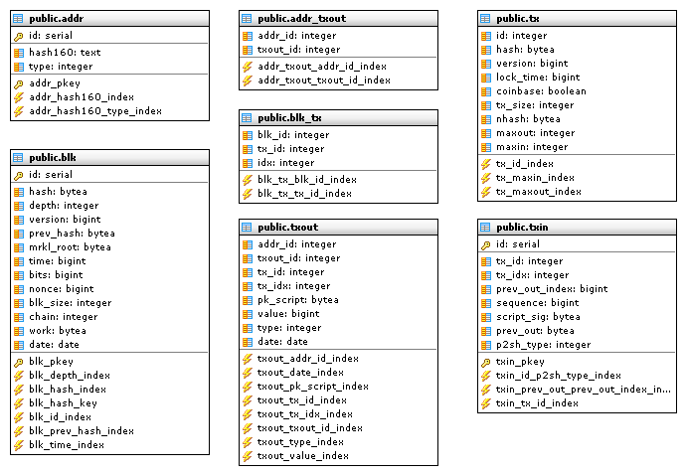

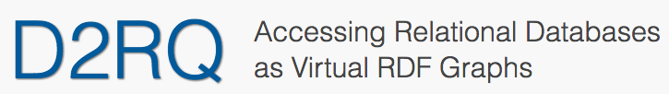
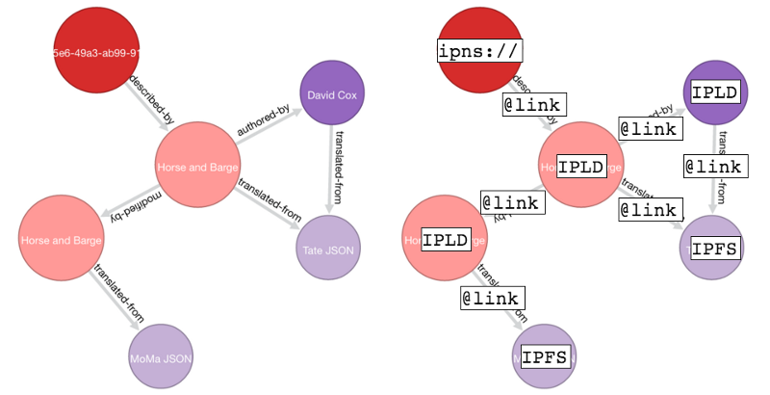

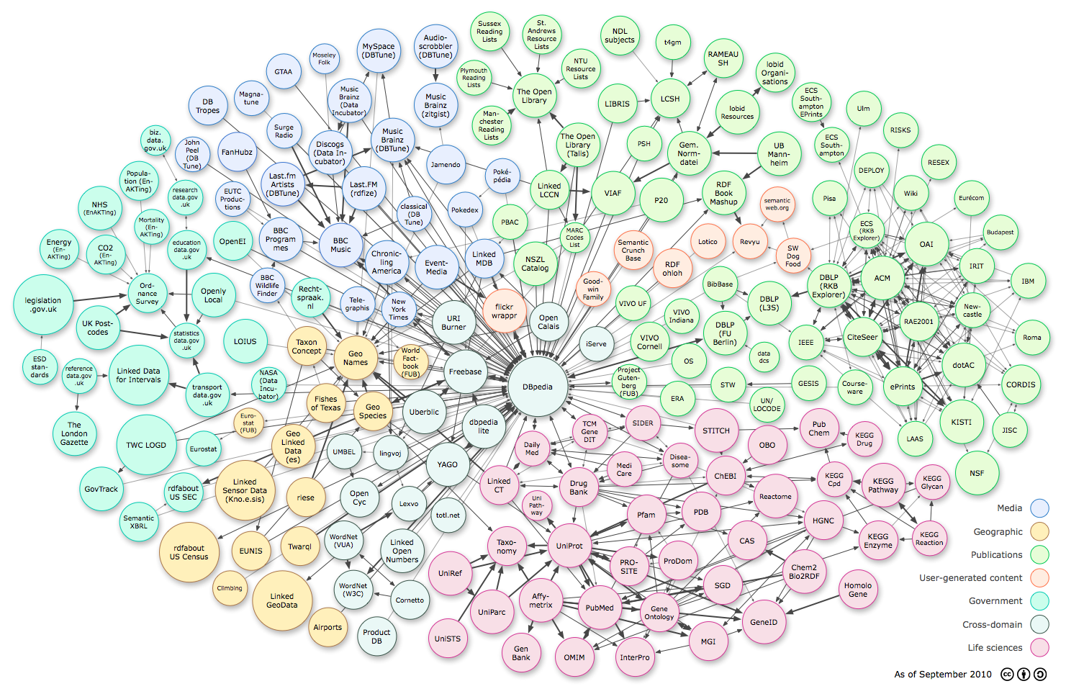
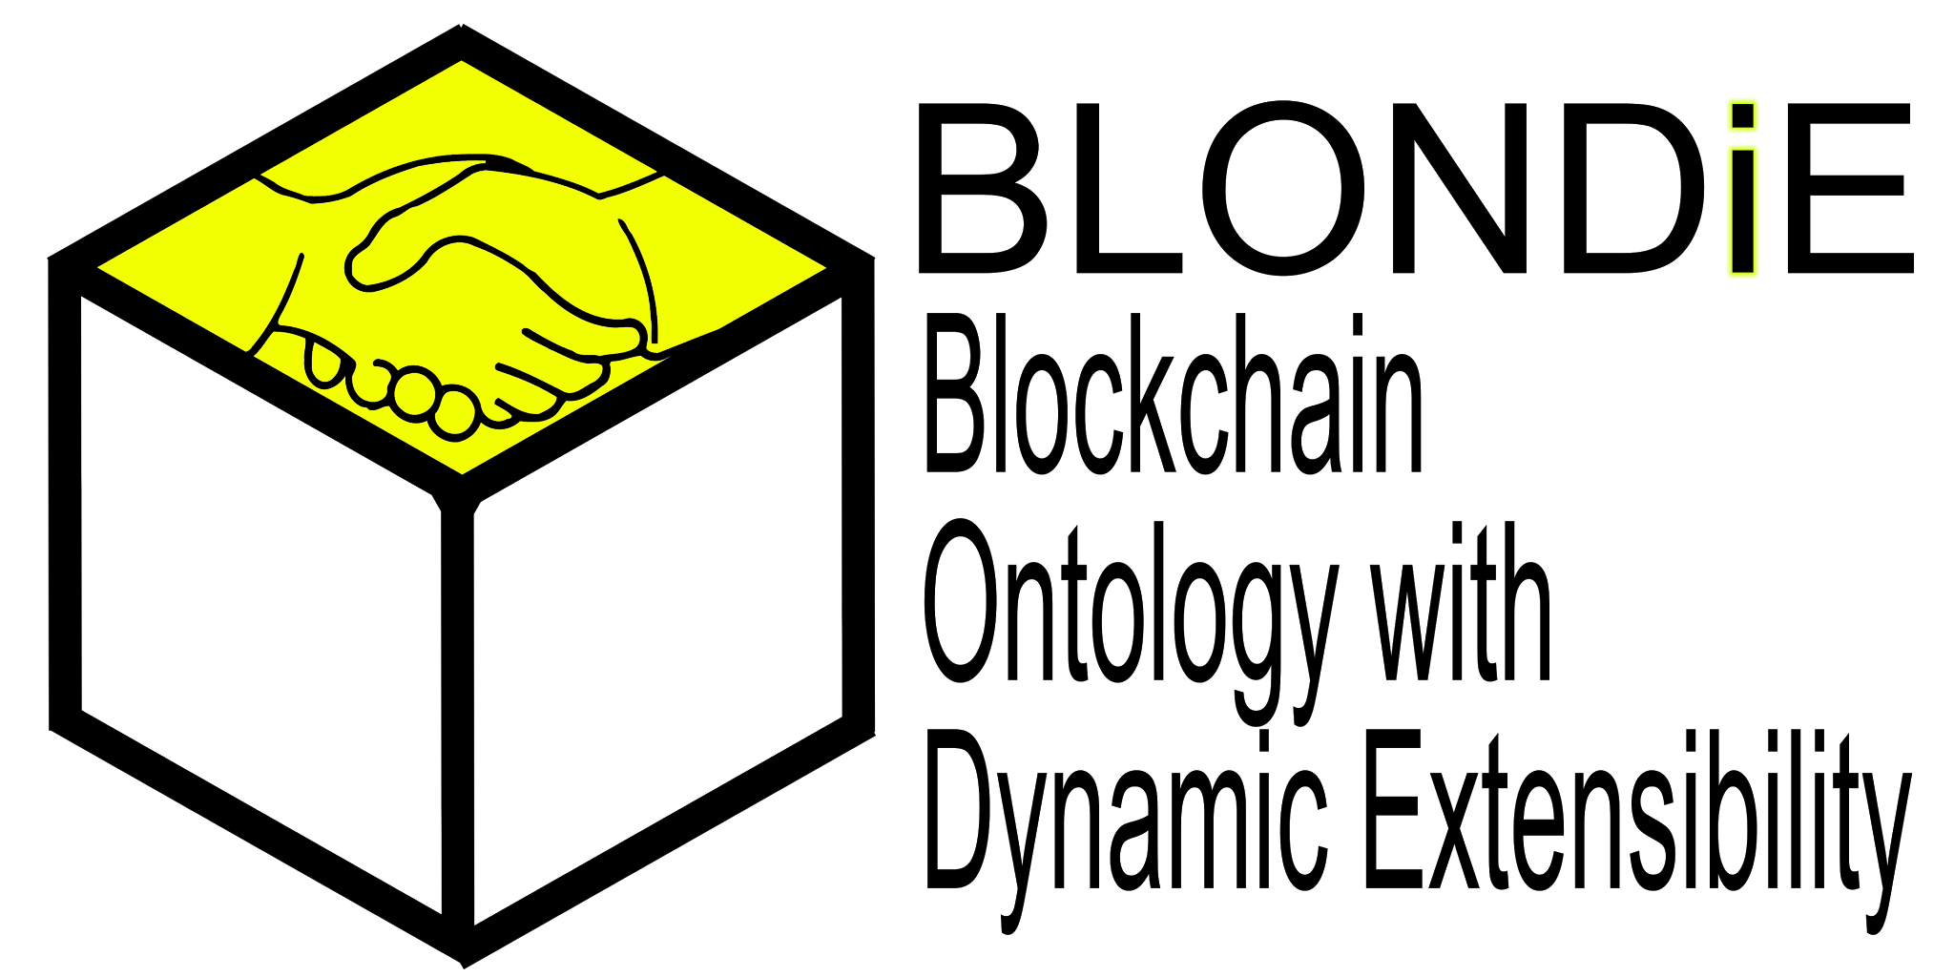
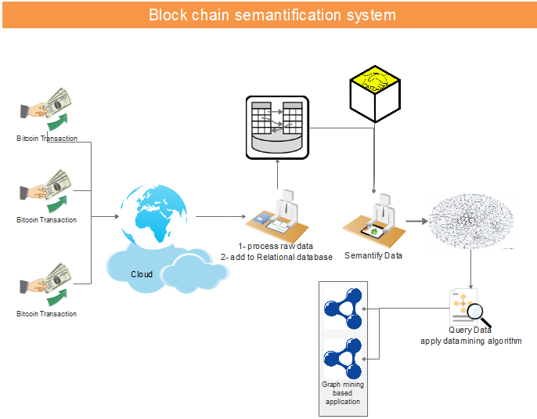
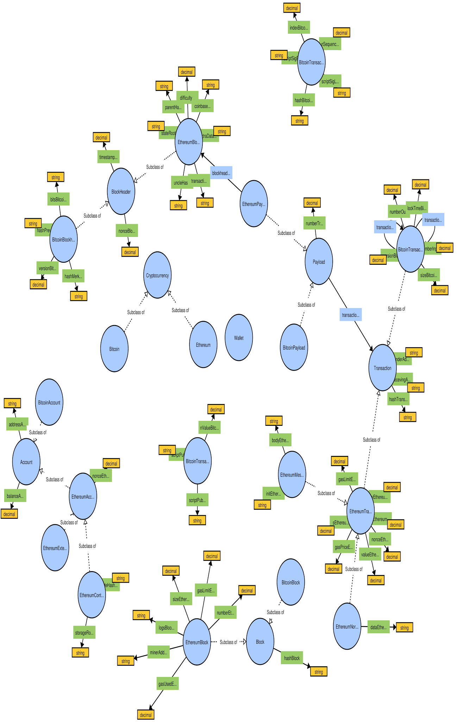
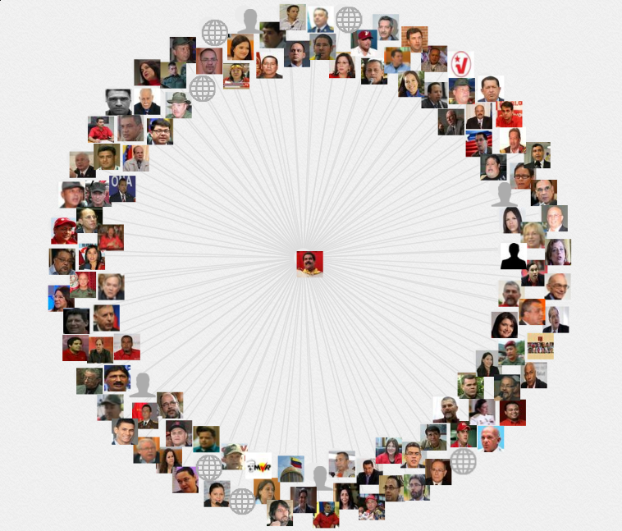

Semantic Blockchain
Team Members:
Firas Kassawat, Ernane Luis, Matthew English
Mentors:
Prof. Dr. Maria-Esther Vidal, Héctor Ugarte
Project Overview
System Architecture
We live in an age where the vast majority of blockchain explorers export the raw data of the transaction network to a relational database.
We aim to export it to a graph database defined according to the RDF specification.
Our proposed project is to create, to the best of our knowledge, the world's first 'Semantic Blockchain'.
This project will produce a graph database (using Semantic technologies) to represent the Bitcoin blockchain, which will facilitate exploratory and visual analytics in addition to subgraph pattern matching as well as user-defined reporting.
Bitcoin
Node
Relational
DB
Semantic Endpoint
Ontologies
Linked
Data
1. Semantically describe the properties of a transaction
2. Ability to link to other data resources
3. Semantic Data Management Techniques
4. Ability to discover patterns
Implementation
ABE: block browser for Bitcoin
REFERENCES
https://github.com/bitcoin-abe/bitcoin-abe
https://blockexplorer.com/
http://silkframework.org/
http://d2rq.org/
http://lod-cloud.net/versions/2010-09-22/lod-cloud_colored.png
EIS
Enterprise
Information Systems

